Slide 1
Role of Vector Embeddings in Sentiment Analysis
Guide name: Dr. Johanan Joysingh S
Team members:
Anushka Pawan 21BAI1215
Aryan Sinha 21BAI1215

Slide 2
INTRODUCTION
What is Sentiment Analysis?
Sentiment analysis is a technique in Natural Language Processing (NLP) that identifies and categorizes opinions expressed in text to determine whether the sentiment is positive, negative, or neutral.
Importance of Sentiment Analysis
Business Insights: Helps companies understand customer feedback, brand perception, and product reviews.
Social Media Monitoring: Enables analysis of trends and public opinion on social media platforms.
Customer Support: Assists in automating responses and prioritizing support based on sentiment.
Applications of Sentiment Analysis
Used across industries such as e-commerce, finance, healthcare, and politics to gauge public opinion and improve decision-making.

Slide 3
Vector Embeddings in NLP
What are Vector Embeddings?
Vector embeddings are mathematical representations of words as high-dimensional vectors. They capture the semantic relationships between words based on their context in a text corpus.
Purpose in Natural Language Processing
Traditional NLP methods struggled to understand context and nuances in language. Vector embeddings address this by encoding meaning and relationships between words.
Role in Improving Sentiment Analysis Contextual Understanding:
Embeddings like Word2Vec, GloVe, and Fastext capture deeper meanings of words, allowing the model to understand sentiment in a better way.

Slide 4
PROBLEM STATEMENT
Traditional sentiment analysis models frequently encounter challenges in accurately capturing context and nuance, which can lead to inaccurate classifications. This research aims to evaluate the effectiveness of various vector embeddings in enhancing the accuracy of sentiment analysis.

Slide 5
Research Objective
The objectives of this research are:
Exploring the impact of vector embeddings on sentiment analysis accuracy.
Comparing different types of embeddings (e.g., Word2Vec, GloVe, fasttext) for sentiment analysis.
Evaluating improvements in sentiment classification with Sentiment Enhanced Word Embeddings.
Comparing the results from different embeddings on Marathi Language movie review database

Slide 6
PROPOSED SYSTEM
Proposed System Introduction
The proposed system aims to enhance sentiment analysis performance by leveraging vector embeddings—Word2Vec, GloVe, and FastText. These embeddings capture word semantics and contextual relationships, improving sentiment classification accuracy compared to traditional models. The system will preprocess the text data, generate word embeddings, train a sentiment classifier using LSTM, and evaluate the model using various performance metrics.

Slide 7
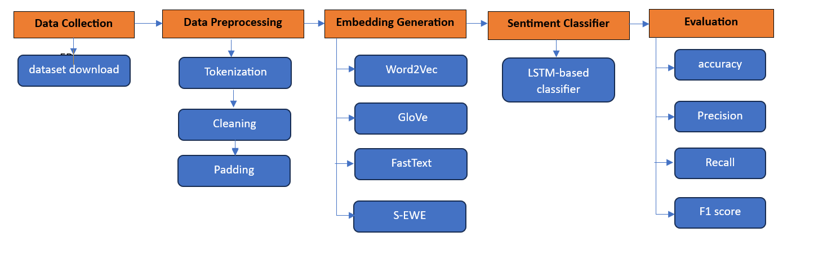
PROPOSED SYSTEM
Proposed System diagram

Slide 8
PROPOSED SYSTEM
List of Modules
Data Preprocessing
Embedding Generation (Word2Vec, GloVe, FastText)
Sentiment-Enhanced Embeddings
Sentiment Classifier (LSTM)
Evaluation (accuracy, precision, recall, and F1-score.)

Slide 9
PROPOSED SYSTEM
Data Preprocessing
Data Cleaning and Normalization: Remove unwanted symbols, punctuation, and numbers. Convert text to lowercase and expand contractions.
Tokenization and Stop-word Removal: Split text into tokens and eliminate common stop-words.
Stemming/ Lemmatization: Reduce words to their base or root forms for consistency.
Vectorization and Sequence Preparation:
Convert text into numerical representations using embeddings (e.g., Word2Vec, FastText, GloVe).
Pad or truncate sequences to a fixed length.
Data Splitting and Class Balancing: Split the data into training, validation, and test sets.

Slide 10
PROPOSED SYSTEM
Embedding Generation
Word2Vec: A neural network-based embedding model that learns word representations by predicting context words (Skip-gram) or surrounding words (CBOW) in a corpus.
GloVe (Global Vectors for Word Representation): A matrix factorization-based model that captures global statistical information about word co-occurrences in a corpus to create word embeddings.
FastText: An extension of Word2Vec that represents words as subword character n-grams, enabling it to handle rare and misspelled words better.

Slide 11
PROPOSED SYSTEM
Sentiment-Enhanced Embeddings
Embedding Layer: A trainable embedding layer learns sentiment-specific word representations (dimension 128) directly from the data during training.

Slide 12
PROPOSED SYSTEM
Sentiment Classifier
LSTM Layer: Captures sequential dependencies in text, preserving context and long-term relationships across words.
GlobalMaxPooling1D: Reduces the output of the LSTM layer to a fixed-size vector by taking the maximum value across the sequence, focusing on the most important features.
Dropout and Dense Layers: Dropout prevents overfitting, while Dense layers refine and classify the features into binary sentiment labels using sigmoid activation.
Compilation: The model is optimized with Adam and uses binary cross-entropy loss for classification, with accuracy as the metric to monitor.

Slide 13
PROPOSED SYSTEM
Evaluation
Accuracy : general idea of performance but can be misleading in imbalanced datasets.
Precision focuses on the quality of positive predictions.
Recall emphasizes capturing as many positives as possible.
F1-score provides a balanced measure that considers both precision and recall, making it suitable for various applications where class distribution is uneven.

Slide 14
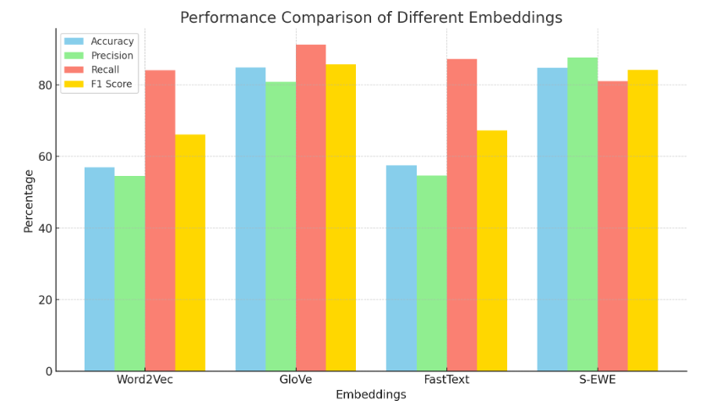
IMPLEMENTATION AND RESULTS

Slide 15
IMPLEMENTATION AND RESULTS
GloVe: Achieved the highest performance due to its ability to capture rich semantic and contextual relationships from large-scale pre-trained embeddings. Its pre-training enhances the model's effectiveness in sentiment analysis.
Sentiment-Enhanced Word Embeddings (S-ewe): Performed well with high precision and F1 score, benefiting from embeddings tailored for sentiment tasks, but showed slightly lower recall, suggesting room for improvement in capturing all sentiment nuances.
Word2Vec: Underperformed as it relies on a shallow neural network and lacks sentiment-specific tuning, limiting its ability to understand broader context and intricate sentiment patterns.
FastText: Slightly better than Word2Vec due to its subword-based embeddings, which help handle unseen words, but it struggles with precision and recall in sentiment-specific tasks.

Slide 16
What to be done next?
Evaluate & Compare Performance Across Datasets: Test each embedding on diverse sentiment datasets to identify the best-performing model for various contexts, domains, and languages.

Slide 17
Research Paper status
“Research Paper drafting is underway; initial sections on introduction, literature review, and methodology have been completed. The other aspects will be completed once the implementation is completed fully.”

Slide 18
REFRENCES
J. Li et al., "Vector Database Systems: A Survey," 2022.
A. K. Singh et al., "Efficient Similarity Search in Vector Databases," ACM Digital Library, 2020.
Y. Zhang et al., "Vector Database for Natural Language Processing," IEEE Xplore, 2022.
T. Meng et al., "Sentiment Analysis Using Vector Space Models," ResearchGate, 2018.
J. Wang et al., "An Efficient Indexing Method for Vector Databases," ScienceDirect, 2020.
H. Chen et al., "Distributed Vector Database for Scalable NLP," 2022.
X. Liu et al., "Vector Database Retrieval for Open-Domain Question Answering," ACL Anthology, DOI: 10.18653/v1/2022.acl-long.331, 2022.
J. Kim et al., "Improving Sentiment Analysis with Vector Space Model," IEEE Xplore,, 2020.
S. Kumar et al., "Vector Database for Multi-Language Sentiment Analysis," ResearchGate, 2022.
Q. Zhang et al., "Efficient Vector Database Search for NLP Applications," 2022.

